Slide 1


FINAL
PROJECT
Performed by Cyber Ghost Team

Slide 2





Alfi Syahrin
@alfi_syahrin_an
Nico Ardimas
@nicoardimas
Gilar Aji
@gilarajie
Mayolla Suci Eksa
@eksa_olla

Slide 3

The Problem &
Analytical Approach
Can the prediction model used reduce the possibility of customers leaving credit card services?
Can the bank determine the policy based on the prediction result?
Bank Manager is disturbed with more and more customers leaving their credit card services

Slide 4
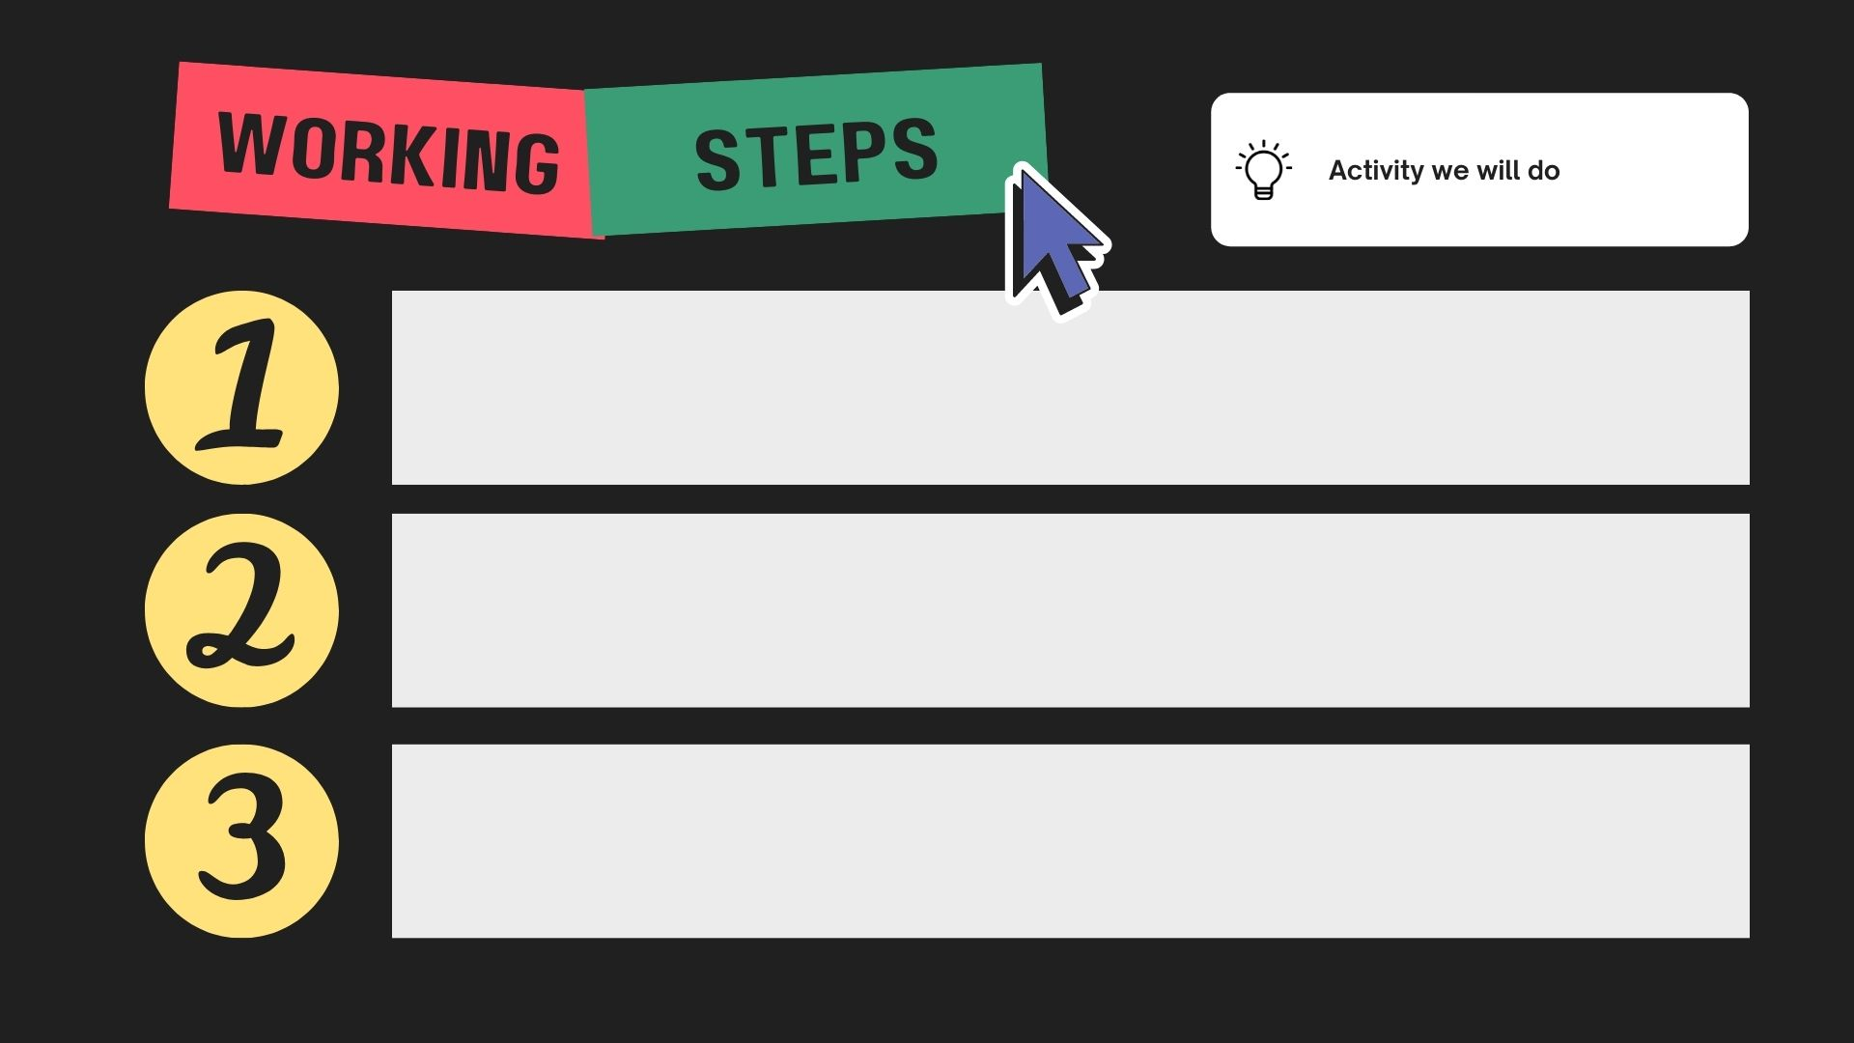
Identify each available variable, the relationship between variables.
Determine the variables that affect the probability of customers leaving credit services.
Build the right machine learning model.

Slide 5

1ST STEP
dtypes: float64(5), int64(9), object(6)
Dependent_count
Income_Category
Total_Relationship_Count
Total_Amt_Chng_Q4_Q1
Attrition_Flag
Credit_Limit
Education_Level
Months_Inactive_12_mon
Total_Revolving_Bal
Total_Trans_Amt
Customer_Age
Card_Category
Marital_Status
Months_on_book
Contacts_Count_12_mon
Avg_Open_To_Buy
Total_Trans_Ct
Gender
Total_Ct_Chng_Q4_Q1
Avg_Utilization_Ratio

Slide 6

2nd
STEPS
Determine the variables that affect the probability of customers leaving credit services (EDA).

Slide 7

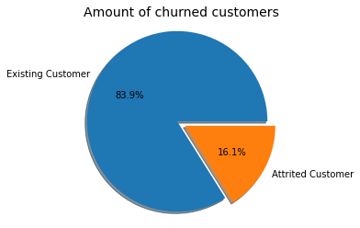

Slide 8

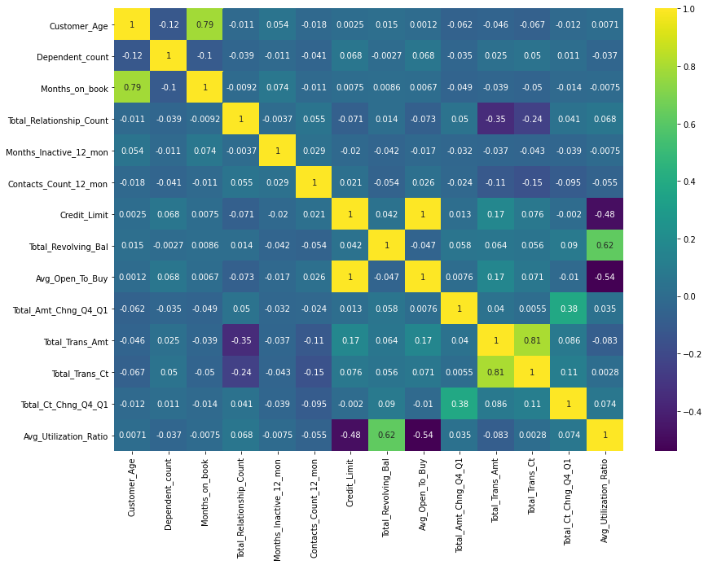

Slide 9

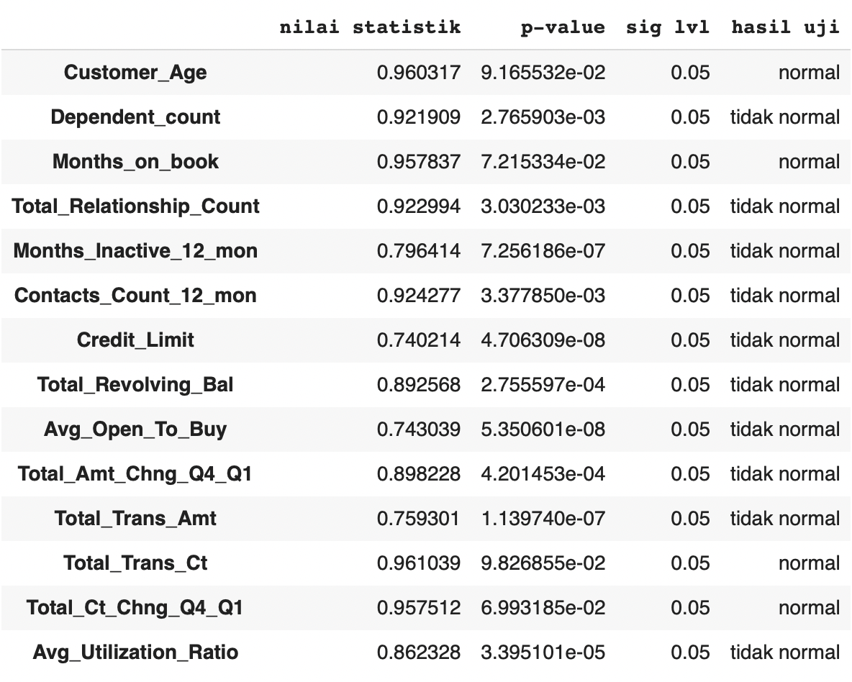
Customer age, months on book, total transaction count, and total count change q4-q1 have normal distribution.

Slide 10
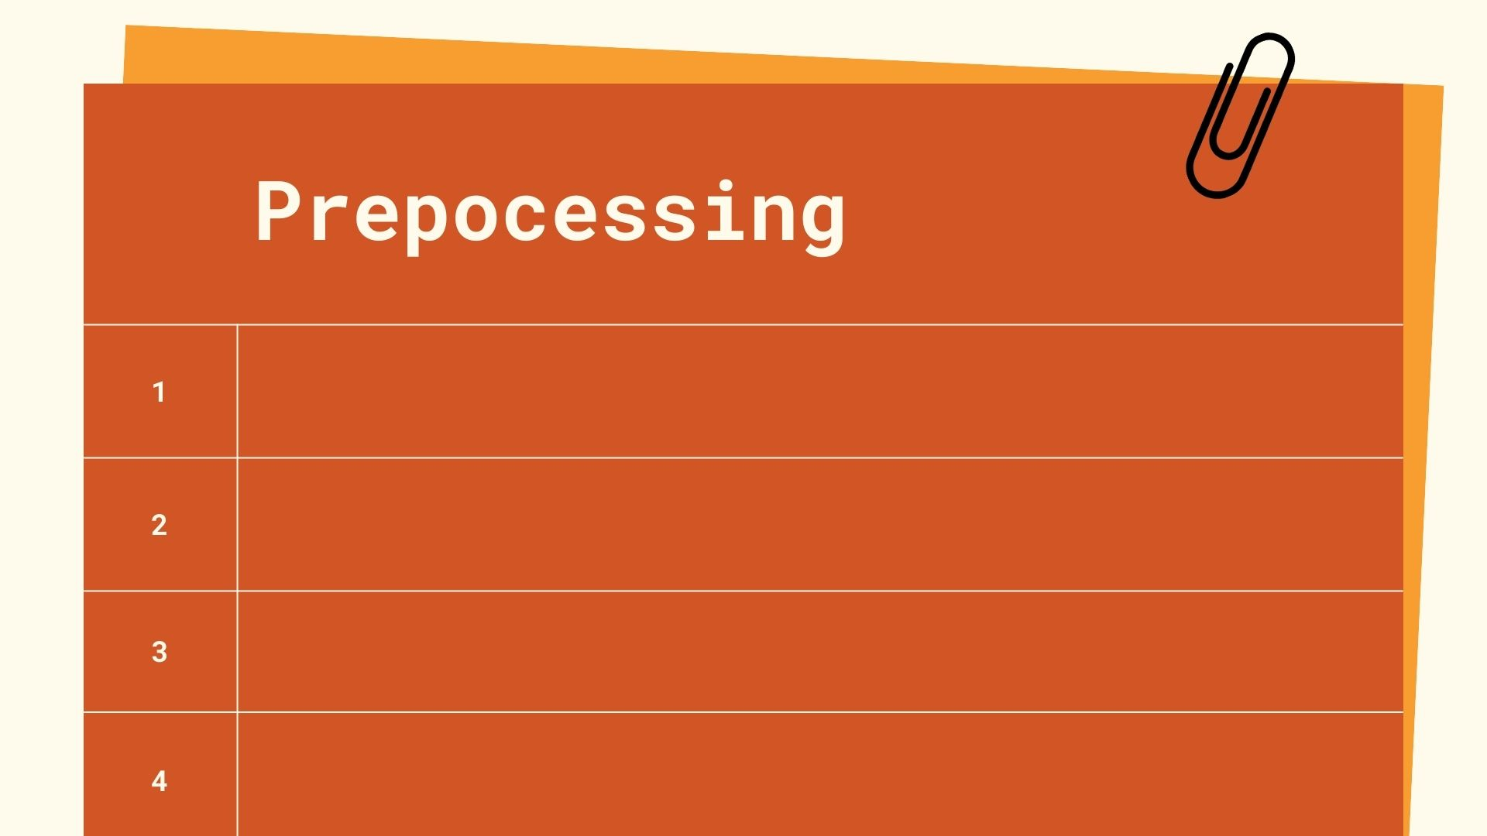
Feature Scalling
Categorical Encoding
Train Test
Imbalanced Dataset

Slide 11
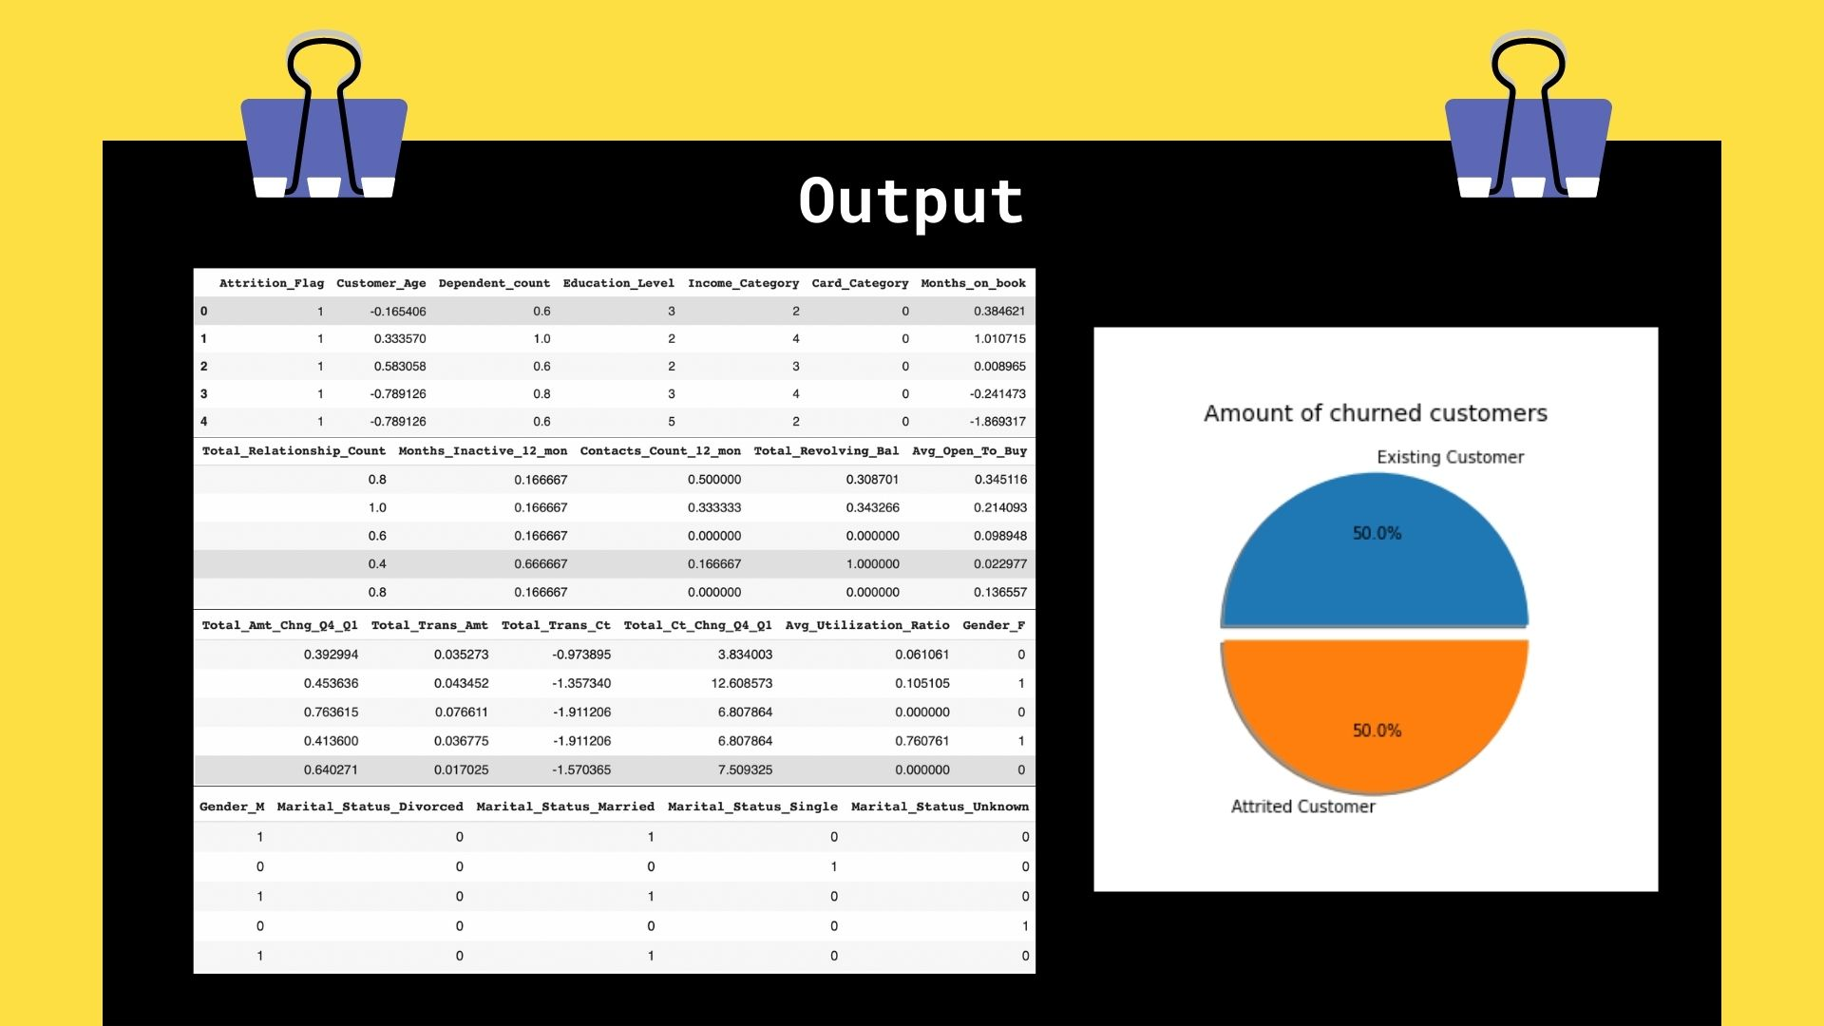

Slide 12

3rd
STEPS
MODELLING

Slide 13
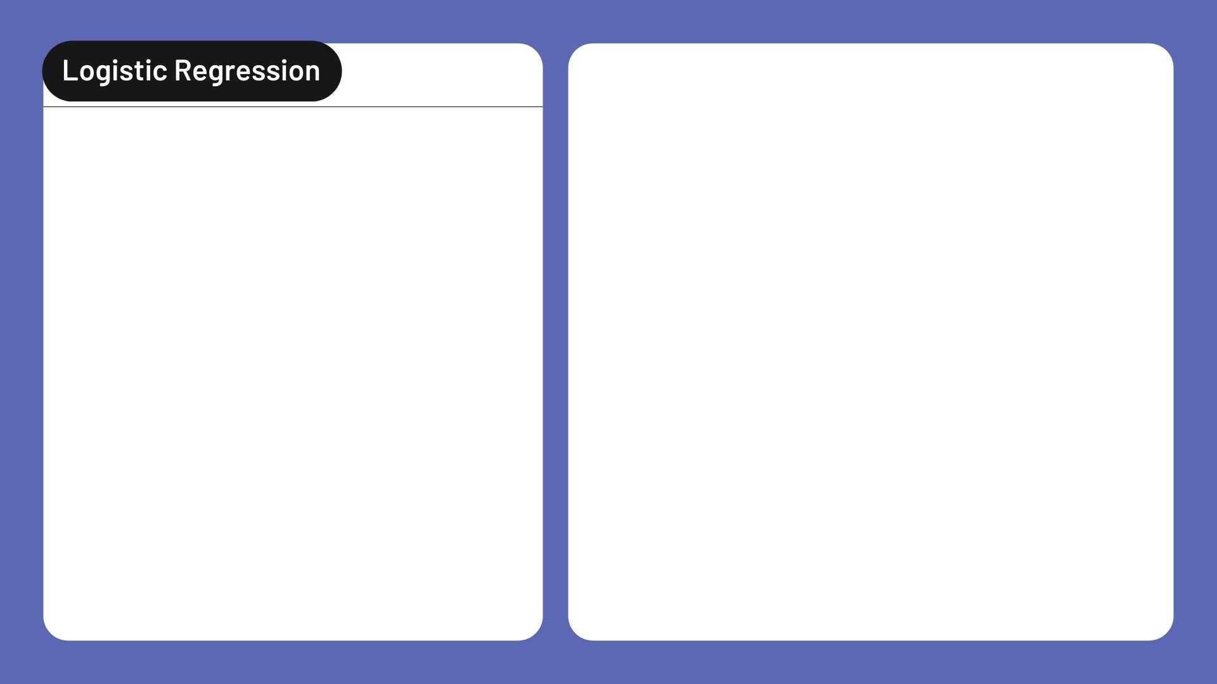
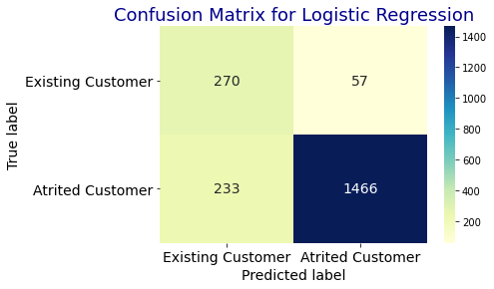
Accuracy 85.69%
Precision 74.97%
Recall/Sensitivity 84.43%
Cross entropy loss 2.2079

Slide 14

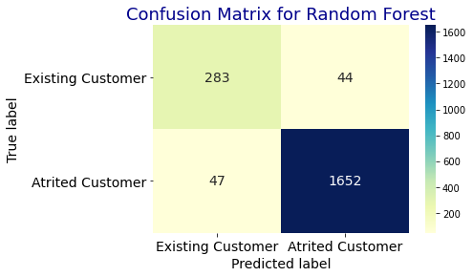
Accuracy 95.51%
Precision 91.58%
Recall/Sensitivity 91.89%
Cross entropy loss 0.6928

Slide 15

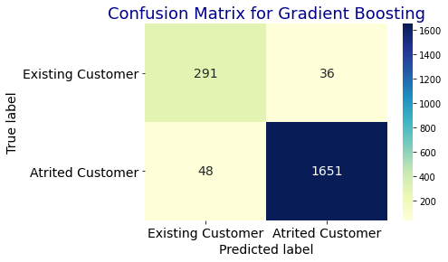
Accuracy 95.85%
Precision 91.85%
Recall/Sensitivity 93.08%
Cross entropy loss 0.6395

Slide 16


Slide 17


